Slide 1

Struktur Data
Stacks
Prepared by
Frans Panduwinata, S.Kom, M.T

Slide 2
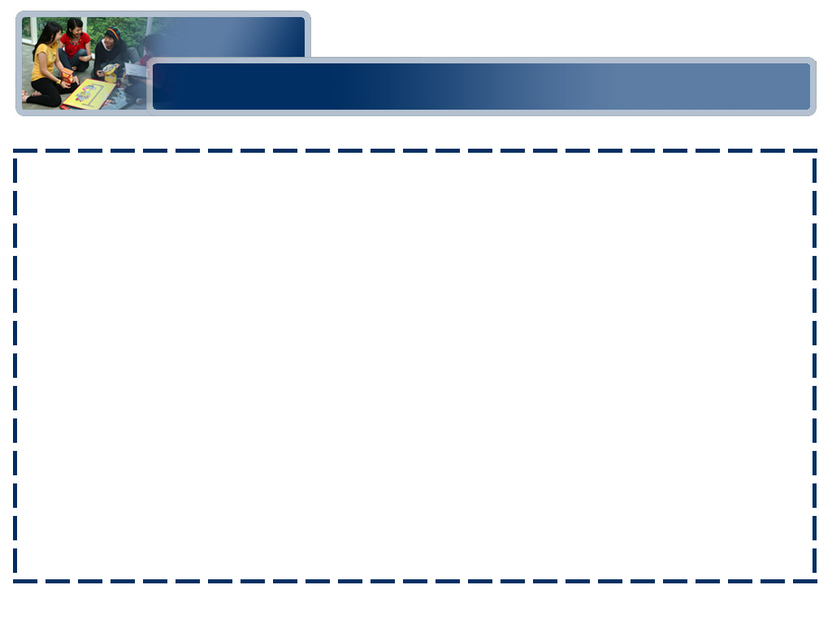
Introduction
A stack is simply a list of elements with insertions and deletions permitted at one end—called the stack top.
That means that it is possible to remove elements from a stack in reverse order from the insertion of elements into the stack.
Thus, a stack data structure exhibits the LIFO (last in first out) property.

Slide 3
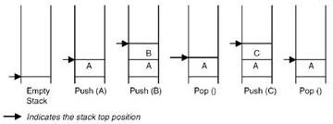
Introduction (cont)
Push and pop are the operations that are provided for insertion of an element into the stack and the removal of an element from the stack, respectively.
Shown in figure below are the effects of push and pop operations on the stack.

Slide 4
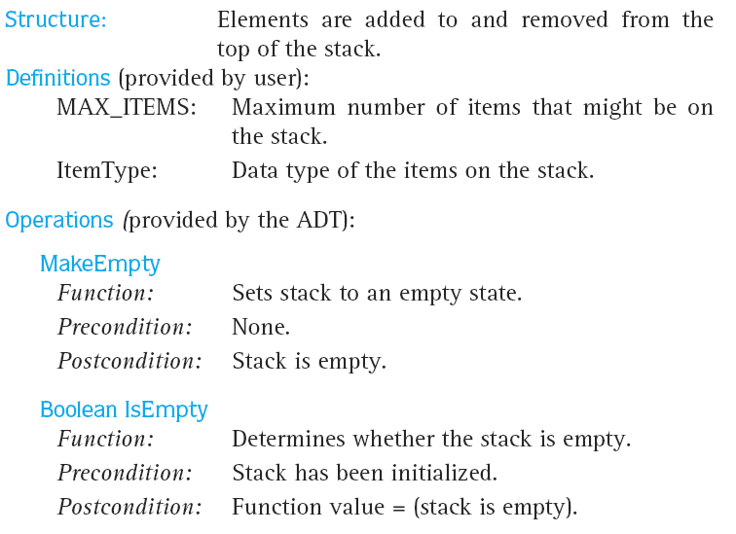
Stack ADT Specification

Slide 5
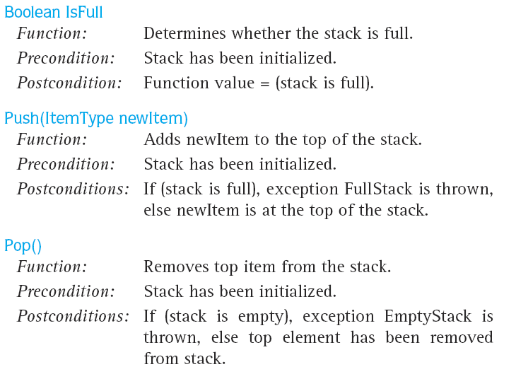
Stack ADT Specification (cont)

Slide 6
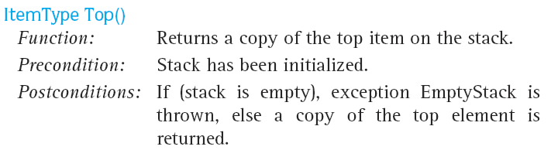
Stack ADT Specification (cont)

Slide 7
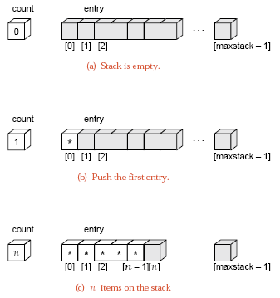
Array Implementation
When an array is used to implement a stack, the push and pop operations are realized by using the operations available on an array.
The limitation of an array
implementation is that
the stack cannot grow and
shrink dynamically as per
the requirement as shown
in the figure.

Slide 8
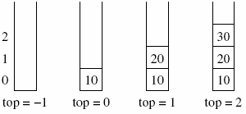
Array Implementation (cont)
EXAMPLE: (Push Function)
void push(int stack[], int *top, int value)
{
if(*top < MAX )
{
//initial *top = -1
*top = *top + 1;
stack[*top] = value;
}
else
{
cout<<"The stack is full can not push a value“<<endl;
exit(0);
}
}

Slide 9
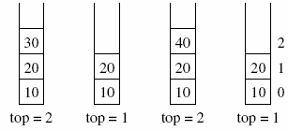
Array Implementation (cont)
EXAMPLE: (Pop Function)
void pop(int stack[], int *top, int * value)
{
if(*top >= 0 )
{
*value = stack[*top];
*top = *top - 1;
}
else
{
cout<<"The stack is empty can not pop a value“<<endl;
exit(0);
}
}

Slide 10
Applications
One of the applications of the stack is in expression evaluation. Such as: a*(b–c)/d
We normally learn mathematics via infix notation.
In infix notation,
  The binary operator comes in between the operands.
  A unary operator comes before the operand.
  To get it evaluated, it is first converted to the postfix form, where the operator comes after the operands.

Slide 11
Applications (cont)
For EXAMPLE,
The postfix form for the expression a*(b–c)/d is
abc–*d/
A good thing about postfix expressions is that they do not require any precedence rules or parentheses for unique definition.
So, evaluation of a postfix expression is possible using a stack-based algorithm.

Slide 12
Applications (cont)
Infix, prefix, and postfix notations samples:
Infix | Prefix | Postfix
(A+B)/D | /+ABD | AB+D/
(A+B)/(D+E) | /+AB+DE | AB+DE+/
(A-B/C+E)/(A+B) | /+-A/BCE+AB | ABC/-E+AB+/

Slide 13
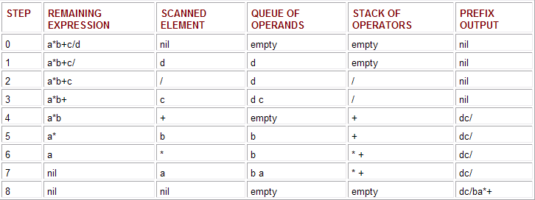
Applications (cont)
EXAMPLE:
Scanning the infix expression a*b+c/d from right to left
The final prefix output: dc/ba*+

Slide 14
Applications (cont)
EXAMPLE: (cont)
  Note that all the operands are simply pushed to the queue in steps 1, 3, 5, and 7.
  In step 2, the operator / is pushed to the empty stack of operators.

Slide 15
Applications (cont)
EXAMPLE: (cont)
  In step 4,
    The operator + is checked against the elements in the stack.
    Since / (division) has higher priority than + (addition), the queue is emptied to the prefix output (thus we get ‘dc’ as the output) and then the operator / is written (thus we get ‘dc/’ as the output).
    The operator + is then pushed to the stack.

Slide 16
Applications (cont)
EXAMPLE: (cont)
  In step 6, the operator * is checked against the stack elements. Since * (multiplication) has a higher priority than + (addition), * is pushed to the stack.
  Step 8 signifies that all of the infix expression is scanned. Thus, the queue of operands is emptied to the prefix output (to get ‘dc/ba’), followed by the emptying of the stack of operators (to get ‘dc/ba*+’).

Slide 17
Exercises
Let A = 2, B = 3, D = 4, and E = 5. Answer the following:
  What is the final value of the prefix expression:
+*AB-CD
  What is the final value of the postfix expression:
BCDAD-+-+
Which of the following is a valid expression (either postfix or prefix)?
BC*D-+
*ABC-
BBB**

Slide 18
Exercises (cont)
Write a program to scanning the infix expressions to prefix and postfix output.
Scanning the infix expressions to prefix and postfix output (with program no 3):
  (A+B)/D
  (A+B)/(D+E)
  (A-B/C+E)/(A+B)

